Slide 1

RISK:
Assessment
Enablement
Management
Rob Mitchell
Ian Burgess

Slide 2
Agenda
Introductions and aims and a brief group exercise
What is risk, and what is a risk assessment and a risk management plan?
How does our risk process flow (gross and net)?
Group work
The new assessment and management tool
Risk enablement

Slide 3
Risky decisions you have made
On your table, people to volunteer to talk about risky decisions you have made, risks you have taken.
We will ask a few people in the room to tell us about them.
Consider for example was anyone worried about it? Did anyone object? Did you spend time thinking about it? Did you need to justify it or convince anyone?
Did you take the risk and what was the consequence?

Slide 4
What is a risk assessment and why do them?
In short, it is to ask: what’s the bad thing that might happen?
If it did happen, how bad would it be and how likely would it be?
A risk assessment is part of a process. Influencing it is the person at the centre of it and their particular set of circumstances, including what they want to do.
A critique from InControl is that a risk assessment is useless to people, it’s just a list of worries written by the professional.
Identifying real threats to their well-being or that of others can be a challenge when other people add their opinion.
You will need to be careful to separate facts from hearsay or the anxiety of others. Your assessment needs to be defensible. A balance sheet approach may be helpful for you and the person.
Spell out the facts which will determine what you or the capacitious person will do next.

Slide 5
Avoiding the protective imperative
In the case of CC v KK and STC 2012
KK was an 82 year old woman with dementia, among other things, pressed her care alarm 1087 times in 6 months. Assessed as lacking capacity and moved into a care home in her best interests.
Court ruled she had capacity to make the decision where to live.
Baker J said social care professionals and the courts, must not be unduly influenced by the “protection imperative” that is, the perceived need to protect the vulnerable adult.

Slide 6

Discussion
What ethical and legal issues might influence your practice?
Do you know where to go if you need advice or guidance?
In the event you have a situation – say it’s a Friday afternoon before a Bank Holiday weekend – and you become aware of a huge degree of unmitigated risk to a person, what initial steps would you take or what might your immediate plan look like?
What might you do if a person, for whom you are the allocated worker, repeatedly makes decisions which are not only risky, but actually impact on her or him?
Is there any benefit from a bad experience for the person?

Slide 7
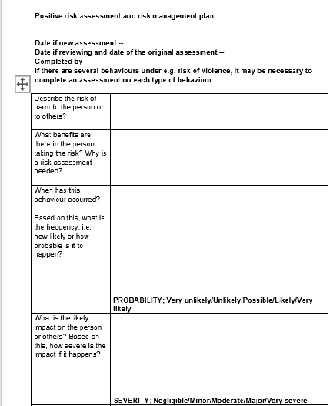
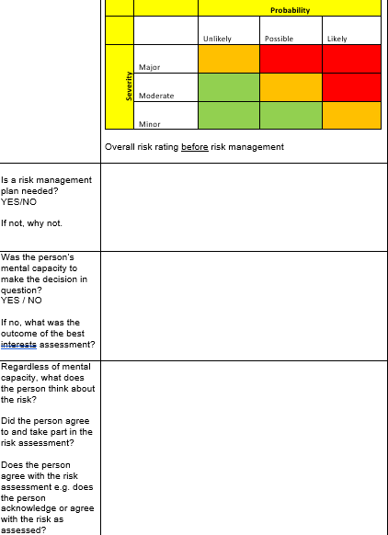
A brief run through the new risk assessment tool…
The last question in the risk assessment:
“Is there anyone legally authorised to make the decision for the person in the event they lack capacity* to make the decision themselves at the time? If so, who? What is the authority and what is the best interest decision that person made?”
*possible exception is LPA for property & affairs

Slide 8
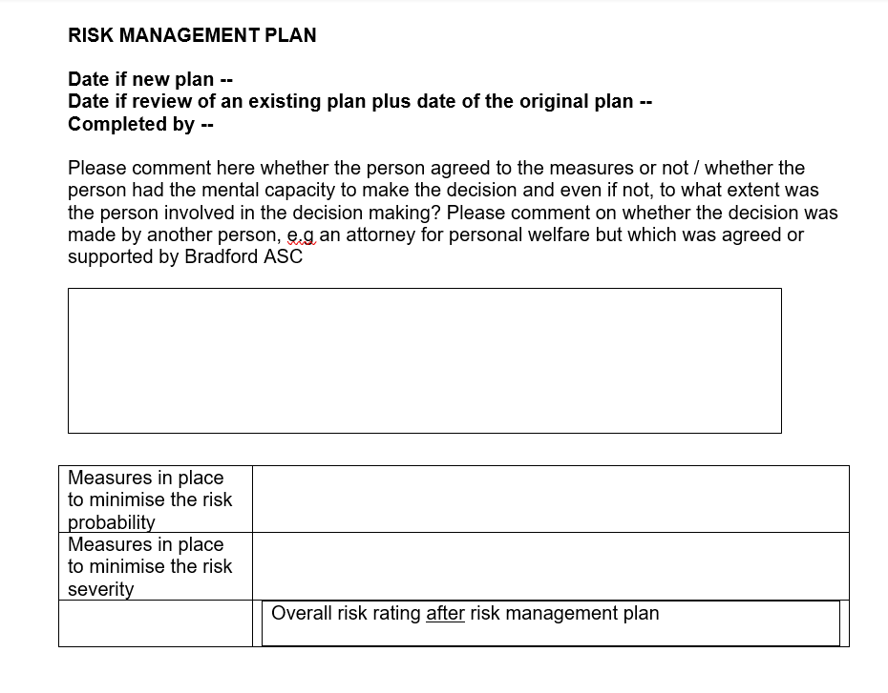
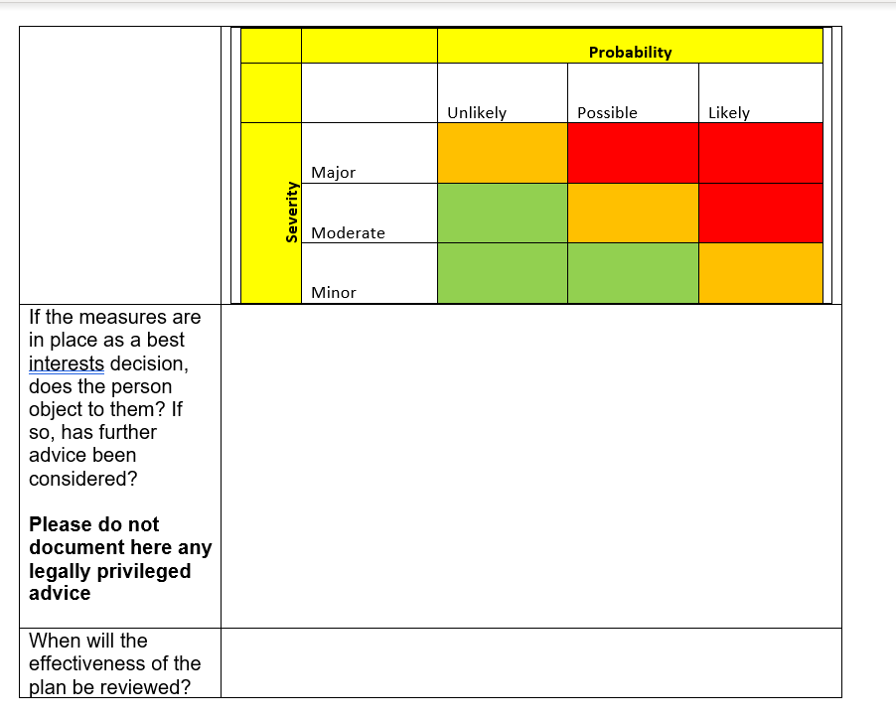
…and the risk management plan

Slide 9
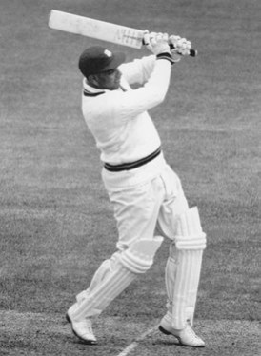
Group exercise – George Walcott scenario
Please read through the scenario and pull out the key things you think are relevant to a risk assessment. What would you take into account? We acknowledge there are going to be lots of other factors, this is just an exercise.

Slide 10
Risk Enablement in Bradford ASC
“Risk enablement recognises that taking carefully considered risks can enable individuals and help improve their wellbeing. Positive risk-taking is a way of working with risk that promotes enablement. It is important to remember that the 'positive' in positive risk-taking refers to the outcome not the risk.” (Local Government Association 2016)
It is not reckless, it is not a negligent dismissal of potential harm, it is a carefully planned strategy for supporting choice. It is a tool to support you in your practice.
The best risk analysis and risk management – including risk enablement – is likely to take place in conversations with the person and in supervision between the worker and their manager.
People are experts in their own lives and professionals bring expertise in assessment and risk management solutions. The Risk Enablement Panel, provides a structure to support the worker in the case of risk being escalated. (Bradford ASC Risk Enablement Framework)

Slide 11
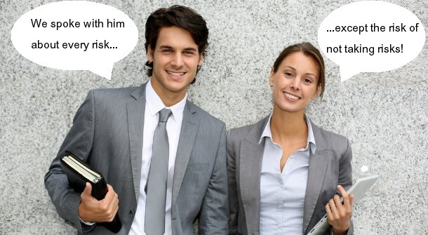
Key principles in risk enablement
1. Involving the person
Enable the person to be involved in considering the risks they face and in planning any actions to address them. Communication with the person should be adapted to their needs.
Some helpful questions (as provided by people with lived experience) to ask may be:
What is important in your life?
What is working well?
What things are difficult for you?
Do you think there are any risks?
Could things be done in a different way, which might reduce the risks?
Who is important to you?
Are there any differences of opinion between you and the people you said are important to you?

Slide 12
Key principles in risk enablement
2. Involve the network around the adult, to the degree the person wishes (e.g. family members, friends, support networks). Strengths and asset based.
3. Multi-agency best practice Involve and work collaboratively with other agencies around the person to gain a full picture, assess risk and plan any strategy to address it. This is especially important where issues are complex and/or the impact of the risk is judged very severe. This will involve sharing information appropriately and reaching agreement as to how to proceed.
4. Assess Risk For each identified risk, you will have completed the risk management plan including gross, mitigation and then net.
Note the strengths of the person and what the risk may help them to achieve (and that they value).

Slide 13
Key principles in risk enablement
5. Risk Management
Consider actions to mitigate the risk. Planning this will involve consideration with the person we support and those important to them around:
the outcomes that the person wants to achieve (their balance between safety and wellbeing);
the resources and assets around the person and in their community, and how these could be used to reduce the risk;
the impact on their wellbeing of any proposed actions to mitigate the risk; and
the emphasis should be upon achieving an acceptable balance between reducing risk and the impact this may have upon the person’s wellbeing.

Slide 14
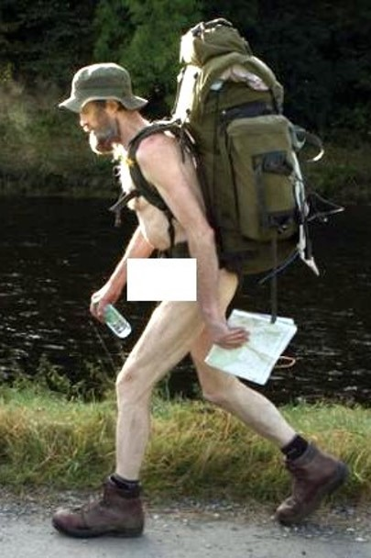
Key principles in risk enablement
6. Risk of harm to others
Consider the impact of the risk, and any action to address it, upon others. Remember that an individual’s right to take risks does not give them the right to put others at risk.
7. Mental Capacity
Consider the adult’s ability to understand and make decisions about the risks they face and where doubt about this exists, ensure that the principles of the Mental Capacity Act 2005 are followed.

Slide 15
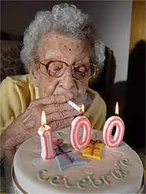
A capacitous person rejecting all offers of risk management
Principles 1 & 3 of the MCA say that unless proven otherwise, every person is able make a specific decision at the time it needs to be made, and that making an unwise decision is not evidence of incapacity, though it might trigger an assessment which the person can still refuse.
Every effort will be made to support the individual with decision making but if the person chooses to live with that level of risk – and to refuse all offers of support – so it goes. But there are still things you can do, including keeping accurate records.

Slide 16
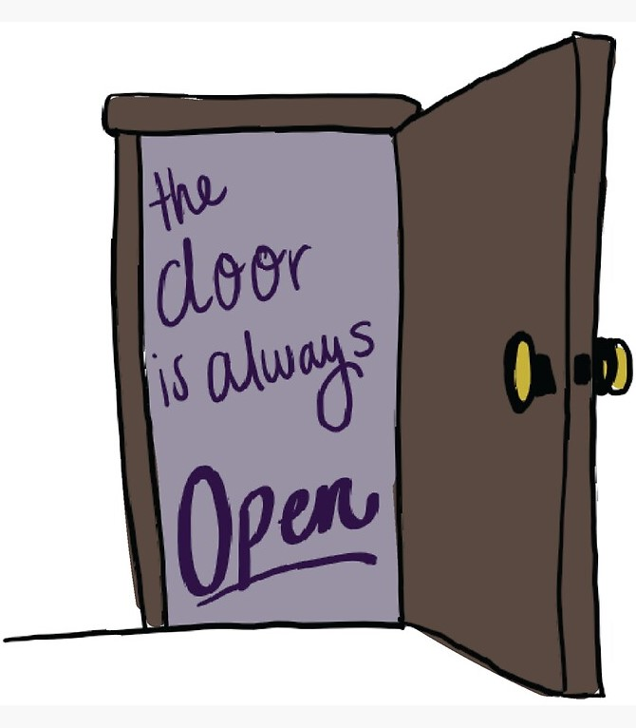
The door is always open
Where such a person informs the worker they do not want anything from the Local Authority, their right to reject offers of support will be respected. However, we do not just walk away and leave them to it; the door will remain open in case the person changes their mind, we maintain contact and will liaise with others to whatever degree we can without it becoming an unjustified interference with their right to respect for privacy. The person will know, maybe via a letter, how to contact the dept in case they change their mind. Nothing is permanent.
If the person says, “I want you to close everything down, make no more records, don’t ever contact me again…” We will respect that, but please do seek advice!

Slide 17
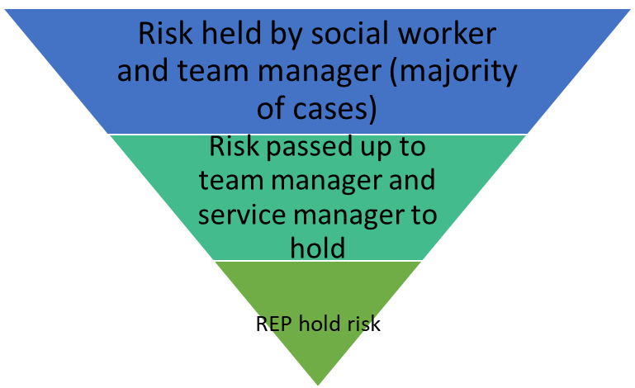
Risk Enablement Panel process
During and following the meeting the Panel will:
Provide a forum to support individuals and staff to consider the potential consequences of any decisions based on pertinent legislation and the guiding principles of this Framework, to arrive at an informed conclusion.
If a decision regarding risk management is reached, agree the specific course of action to be taken following Panel.
Provide advice to the service or individual responsible on the course of action that they should take.

Slide 18
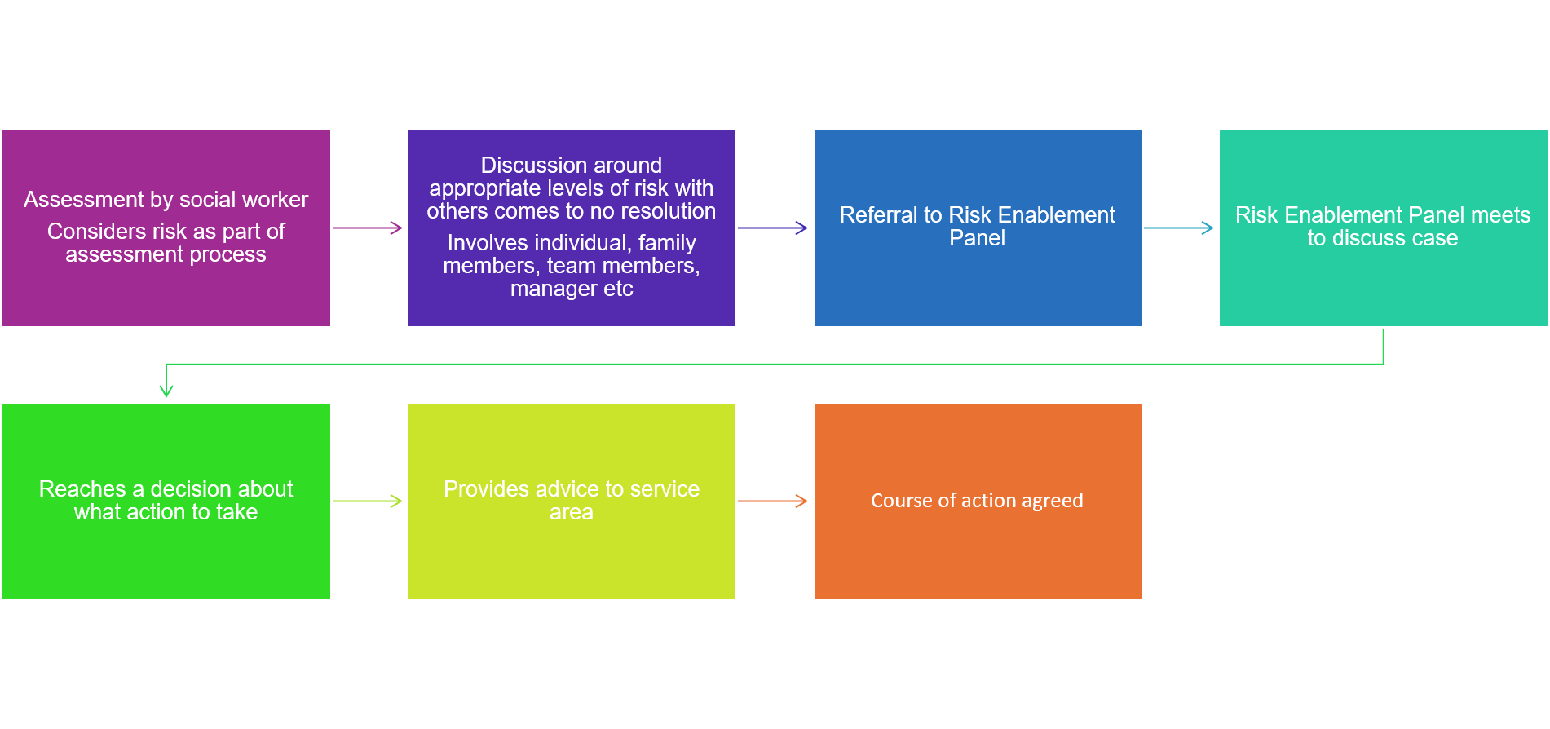
REP process

Slide 19
Any questions or thoughts?
“What good is it making someone safer if it merely makes them miserable?”
Mr Justice Munby (as he was then), Re MM (an Adult); Local Authority X v MM & Anor [2007] EWHC 2689
Further reading – check out the concept of ‘Dignity in risk’ and the United Nations Convention on the Rights of Persons with Disabilities

