Slide 1
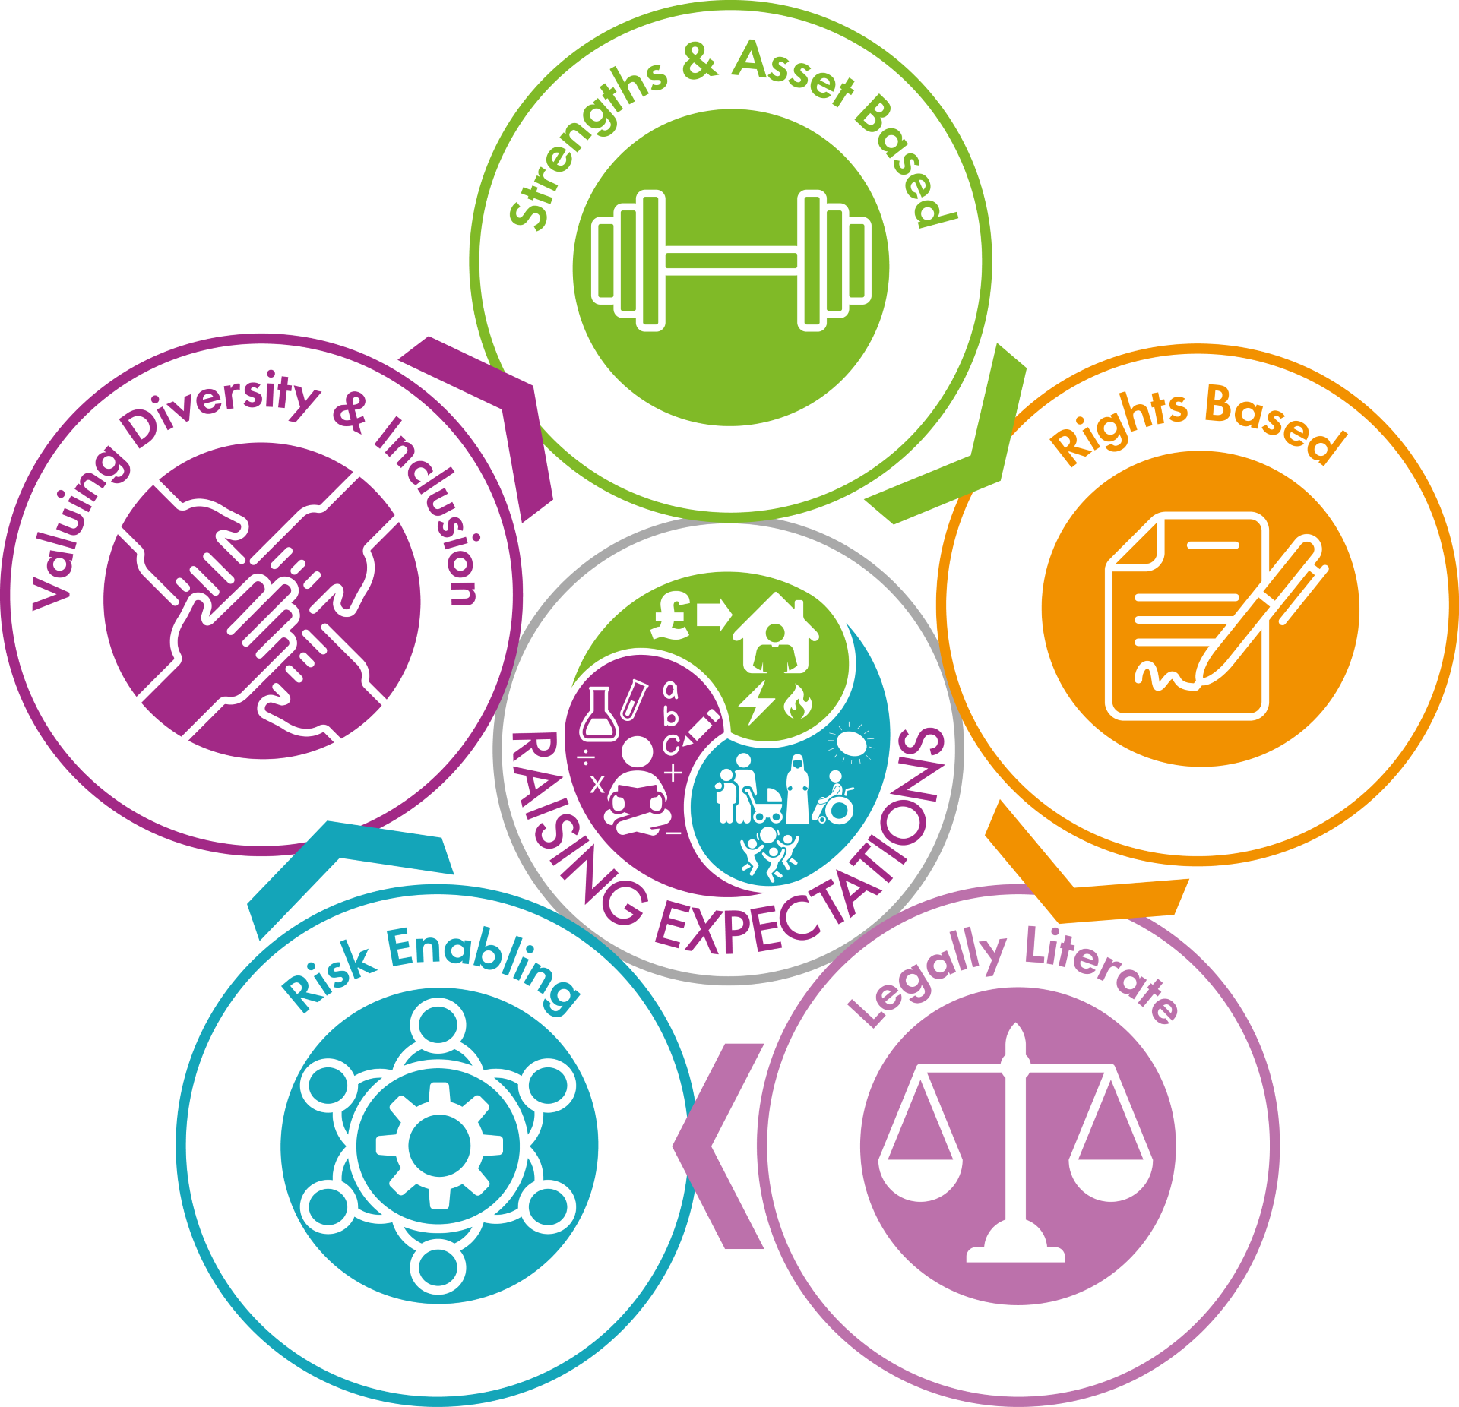
Our Practice Model

Slide 2
Valuing Diversity and Inclusion
Jennifer Holroyd and Hira Zafar

Slide 3
THEORY
Knowledge of Diversity and Inclusion.
APPLICATION
Aims and Objectives
Understand impact of Bias and Stereotypes
PRACTICE
Application to Practice

Slide 4
THEORY
Knowledge of Diversity and Inclusion.
APPLICATION
Aims and Objectives
Understand impact of Bias and Stereotypes
PRACTICE
Application to Practice

Slide 5
THEORY
Knowledge of Diversity and Inclusion.
Aims and Objectives
APPLICATION
Understand impact of Bias and Stereotypes
PRACTICE
Application to Practice

Slide 6
THEORY
Knowledge of Diversity and Inclusion.
Aims and Objectives
APPLICATION
Understand impact of Bias and Stereotypes
PRACTICE
Application to Practice

Slide 7
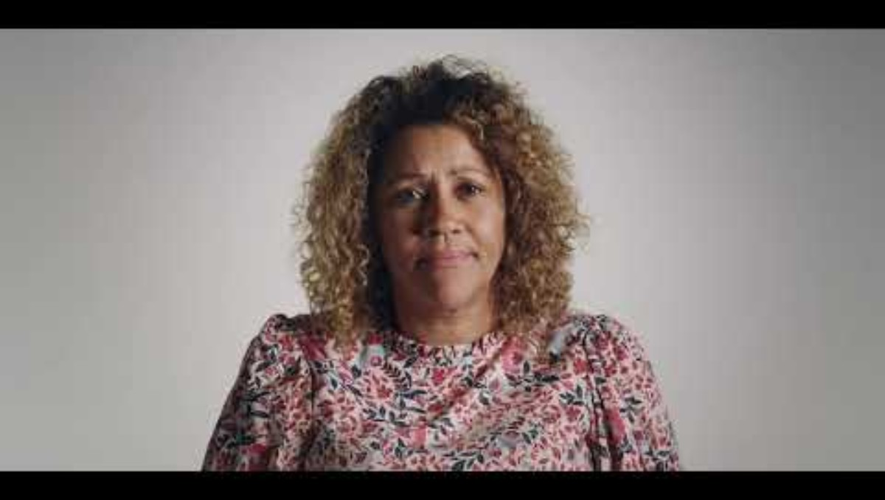

Slide 8
Myth Buster
Each table has been given a list of statements. As a table take 10 minutes discuss any three of these statements, decide whether they are true or false and explain your answer.
Don’t forget to agree who feeds back!

Slide 9
Myth Buster Feedback
Pick one of your statements to feedback to the wider group.

Slide 10
Some Statistics:
76% of individuals from an ethnic minority background report experience bias in service delivery (Race Equality Foundation 2022)
45% of individuals with a disability say that Social Workers underestimated their capabilities (SCOPE, 2023)
It was reported in 2021 that South Asian elders face language barriers in dementia care. With only 12% of support plans translated into a language understood by the person (Urdu, Punjabi). (Bradford District ICB, 2021)
Disabled Children in deprived Bradford areas wait 18 months longer for EHCP’s than affluent peers (BDC local offer report, 2023)
Only 1 in 5 South Asian women with depression seek help due to stigma (Bradford Institute for health research, 2020)
In 2012, the Leveson Inquiry concluded that press reporting on immigrants and ethnic minorities was often sensational and unbalanced and that there was a tendency within certain sections of the press to publish ‘prejudicial or pejorative references to race, as well as to religion, gender, sexual orientation or physical or mental illness or disability’ (Leveson, 2012

Slide 11
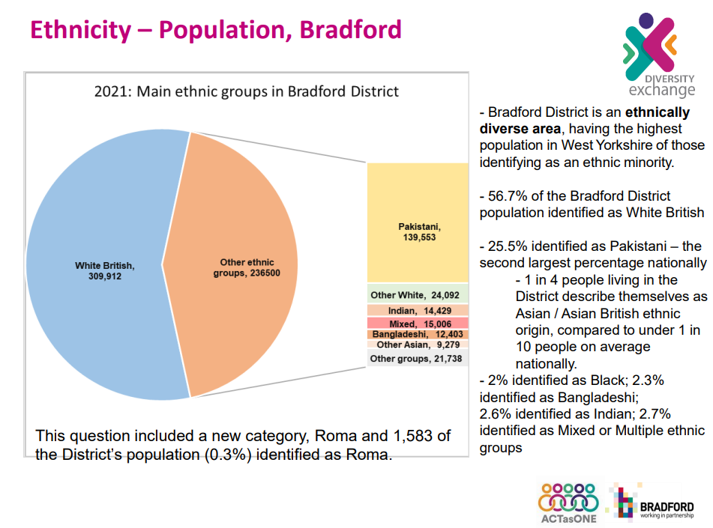

Slide 12
More statistics here:
Data Pack Protected Characteristics Bradford

Slide 13
We take all practicable steps to make reasonable adjustments which enable supported decision making and inclusion, including culturally competent and anti-racist practice, recognising the strength of diversity and diverse approaches.

Slide 14
Let’s Break it Down

Slide 15
What do we mean by ‘Practical Steps’?
Reflect on your own identity and bias.
Use inclusive and respectful language – ask the person how they identify, use people first or identity first language.
Understand the persons cultural contexts – ask about family structures, traditions, values, religion, or migration story. Don’t assume shared meaning – inquire gently about ‘family’ support.
Continue education on Diversity and Anti-Oppressive Practice – stay up to date on emerging issues.
Advocate for equity in systems – identify policies that disadvantage specific groups, speak up in meetings when bias or inequality appears – Equity Pauses!
Adapt Assessments and Interventions – Use culturally adapted tools where possible .
Validate non mental expressions of mental health e.g. somatic symptoms, spiritual concerns.
Build culturally safe relationships i.e. prioritise trust, respect and non-judgement listening.
Empower people by emphasizing their voice in decision making
Acknowledge when you don’t know something and ask respectfully.
Create feedback loops, ask people and communities about ongoing feedback about how inclusive and
respectful your practice feels. - bridge the gap with local resources
Model and promote inclusion in your team - equity pauses!
Notes:
A great first step is to understand our own identity and bias. This will help us to ‘check ourselves’ regularly.

Slide 16
What do we mean by ‘Reasonable Adjustments’?
Work effectively with interpreters and accessible services – offer interpreters, don’t assume English proficiency or that a family member will/can translate.
Use accessible formats – braille, large print, easy read or audio)
Allow extra time during assessments or meeting for people with learning disabilities or cognitive differences
Using quiet low stimulus spaces for people with autism or anxiety
Translate key documents i.e. Assessments and support plans
Avoid jargon using plain clear language
Be flexible with meeting times re prayer, fasting and holy days
Respect gender-based preferences for professionals i.e. some people may prefer a female worker for religious reasons
Offering visits/meeting in accessible spaces where mobility/travel is a barrier
Consider what somebody's communication preferences are i.e. offering alternatives to face to face meetings

Slide 17
What do we mean by ‘Reasonable Adjustments’? Key Principles
Making reasonable adjustments is a legal requirement under the Equality Act 2010. Ethically, it aligns with Social Work Values of empowerment, anti-oppressive practice and respect for human dignity.
Principle | What it Means
Proactive | Don’t wait to be asked – consider likely needs in advance
Individualised | Tailor adjustments to the person, not the group
Proportionate | Balance the persons needs with resources available.
Flexible | Be open to adapting usual procedures or timeframes.

Slide 18
What do we mean by ‘Inclusion’?
Inclusion is the practice of ensuring all individuals, especially those from marginalised or vulnerable groups, have equal access, meaningful participation and tailored support in services, decisions making and life opportunities.

Slide 19
What do we mean by ‘Inclusion’? Points to remember:
People are experts in their own lives!
Be open to different world views, traditions, family structures and norms
Avoid assumptions based on race, religion, gender, age, sexuality etc
Equity and not just equality - adjust support based on need
Awareness of power and bias – recognise how systems, policies and personal attitudes may marginalise people
Commitment to anti oppressive practice and challenging discrimination when it appears

Slide 20

Let’s Play a Game??
A game…. Of Inclusion….
Notes:
Equality vs Equity
Systemic Barriers
Privilege and Perspective
Inclusive practice

Slide 21
Break

Slide 22
What do we mean by ‘Culturally Competent’ Practice?
Culturally competent practice is the ability to understand respect, and respond appropriately to cultural beliefs, values and experiences of people from all backgrounds.
Key Principle | What it Means
Self Awareness | Recognising your own cultural identity and bias.
Cultural Knowledge | Learning about different cultures, communities and social norms especially those of people you serve.
Skills for engagement | Adapting communication, assessments and interventions to be relevant to each person's cultural context.
Cultural Humility | A lifelong commitment to learning from people rather than assuming expertise based on stereotypes or past experiences.

Slide 23
What do we mean by ‘Anti-Racist Practice’?
Anti racist practice means actively identifying, challenging and changing the values, structures, behaviours and policies that perpetuate racism, both within social work systems and in society at large. It goes beyond "not being racist". It involves taking actions against racial prejudice.
Key Principle | What it Means
Exposing systemic racism | Acknowledging that social work systems can disproportionately harm people from ethnic minority backgrounds.
Challenging white normativity | Questioning default standards that marginalise non white experiences.
Valuing Lived Experience | Valuing the voices of people from ethnic minority backgrounds in shaping the policy, practice and decision making.
Redistributing power | Advocating for equity in access to resources, representation and leadership.

Slide 24
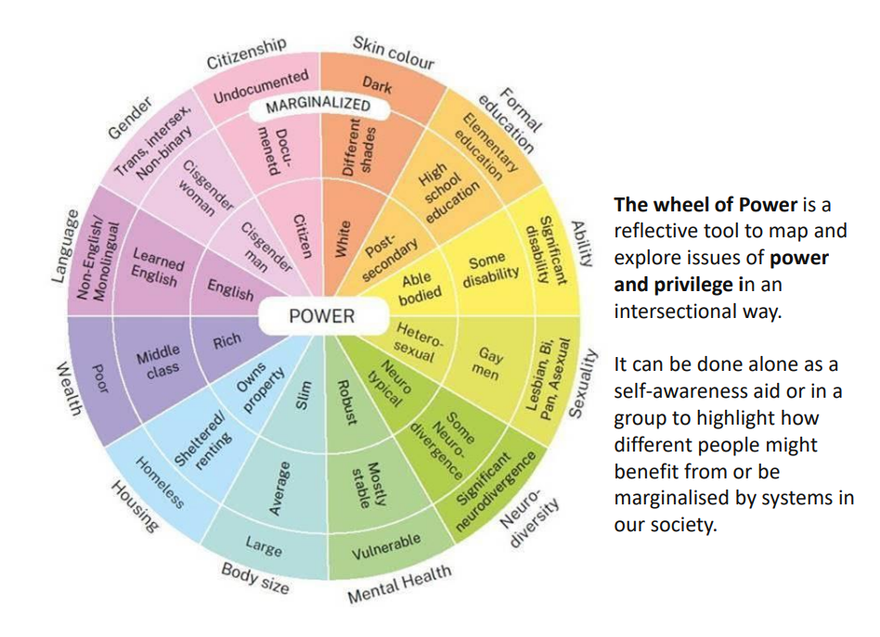

Slide 25
Wheel of Power – Group Task and Individual Task
In a group, choose ONE spoke of the wheel. Design a 'power shift' for our service.
For example:
Now, independently, place yourself on 2-3 spokes of the wheel and consider:
Where do you hold power?
Where do you face barriers?
Spoke | Current Power Imbalance | Practicable Solution
Language | Forms only in English | Translate to top 3 languages and use pictograms

Slide 26
“Diversity is being invited to the party; inclusion is being asked to dance”
Vernā Myers

Slide 27

Notes:
Being inclusive benefits everyone!!!!!

Slide 28
Before you leave..
A commitment please..
"One action I will take to be more inclusive in my work from today is.........................................................................."

Slide 29
THANK YOU!!

Slide 30
Refs and Reading
Older LGBTQ+ people and social care
Care Act guidance on strengths-based approaches – SCIE
Social care practice, strengths-based practice and meaningful relationships in hybrid working – SCIE
Matching interventions and people: A decision-making tool – SCIE
PowerPoint Presentation

