Slide 1

Bradford ASC
Practice Model
Vicki Ellis
Hira Zafar
Jen Holroyd
Rob Mitchell
Ian Burgess
Rob Mitchell
Ian Burgess

Slide 2
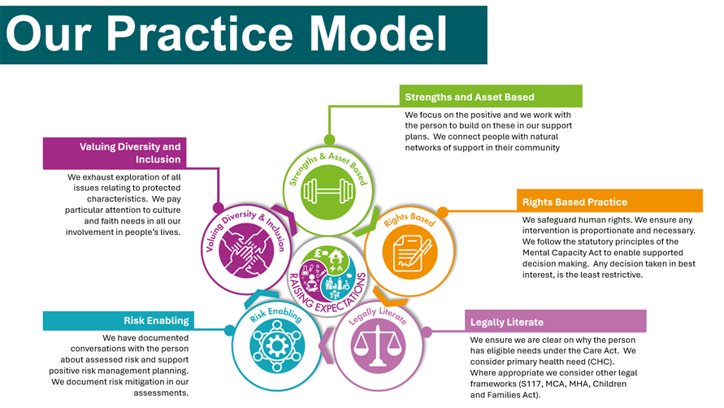

Slide 3

Rights
Based
Phillip and Barry

Slide 4
Rights Based
Philip and Barry live in supported living. Both have a learning disability and Barry is visually impaired too.
The provider’s setting comprises two buildings with a connecting door between the two houses with four men living in each house with staff on duty round the clock, funding mixed between the LA and CCG.
Philip initiates sexual relations with Barry; the two men have been friends for over 25 years and enjoy each other’s company, holding hands and spending time together. It is evident they both enjoy having sexual relations.

Slide 5
Rights Based
It was determined both men lacked the mental capacity to consent to sex. Best interests meetings ahead of the week in court planned to hear the matter resulted in different positions; the CCG (ICB) wanting the men to move apart, the LA wanting the men to remain together.
References were made to IM v LM (2014) in the Court of Appeal where “if, in any case, there is a declaration of lack of capacity, the relevant local authority must undertake the very closest supervision of that individual to ensure, to such extent as is possible, that the opportunity for sexual relations is removed.”
At the time, IM v LM & Others [2014] EWCA Civ 37, was the definitive case law on the delicate matter of consent to sexual relations.

Slide 6
Rights Based
Given the case law, IM v LM – that the LA must ensure opportunities for sexual relations are removed so far as possible - the legal advice we received was that we do not need to go to Court. The interim advocacy manager said we need to issue proceedings and if we didn’t, she would. We didn’t; she did. She was right to, but why?
The Strategic Director for the LA believed that the men should be allowed to have sex and that it was a terrible interference with their rights to prevent sexual relations. Was that correct?
The best interests discussions with the CCG included them proposing moving various men in the two buildings around. Initially our position agreed with that but the social worker insisted we should not do that. Do you think she was right, and if so, why?
The judge said, “These men don’t have much in their lives do they?” What do you think his final decision was, and why?

Slide 7
Legally Literate
Mental Capacity Act 2005
Section 1(2) A person must be assumed to have capacity unless it is established that he lacks capacity.
Section 1(3) A person is not to be treated as unable to make a decision unless all practicable steps to help him to do so have been taken without success.
Section 2(1) For the purposes of this Act, a person lacks capacity in relation to a matter if at the material time he is unable to make a decision for himself in relation to the matter because of an impairment of, or a disturbance in the functioning of, the mind or brain.
Section 2(3) A lack of capacity cannot be established merely by reference to –
(a) a person's age or appearance, or
(b) a condition of his, or an aspect of his behaviour, which might lead others to make unjustified assumptions about his capacity.

Slide 8

Legally Literate
Re FX [2017] EWCOP 36
Note: The Court of Protection only has jurisdiction where the person does not have the mental capacity to make the decision.
In this case, the person was already the subject of a DoLS standard authorisation and that was being challenged (section 21A).
However the Best Interests Assessor determined ‘FX’ did have capacity to decide and sought to have the proceedings terminated, in other words, FX would make the decision not the court. The decision for the judge was to determine whether or not FX had the mental capacity to make decisions about care and residence (and other things).

Slide 9
Legally Literate
FX maintained he had capacity to make a range of decisions and objected to a move planned by the funder (CCG) from one care home to another in his best interests.
FX had Prader-Willi Syndrome. The BIA gave evidence, as did Professor Holland, an expert in PWS.
FX would talk about lots of things, including his care and residence needs, but not his illness which he found embarrassing to talk about.
The BIA said he had capacity because she could not prove he lacked capacity, that is, the first Principle of the MCA was not rebutted. The Professor came to the opposite conclusion.
Professor Holland only met FX once, where FX himself said “I know SN, I open up to her.”
“SN has different qualifications to those of Professor Holland… She had the advantage of being able to meet more extensively with FX and was able to have more productive discussions with him. She conducted her assessment from the correct starting point of presuming that FX has capacity and applying the relevant statutory framework and guidelines.”

Slide 10
Legally Literate
Alex Ruck Keene wrote, “…the judgment stands as an object lesson in following the route map of the MCA with care: despite the superficial disparity in expertise in relation to PWS, SN's care in following the route map of the MCA meant that her evidence carried greater weight than did that of Professor Holland.”
What can you take from that? What does that mean to you?
In court, the judge was “…satisfied that his reluctance to discuss his PWS arises from embarrassment and frustration. This explanation does not, in itself, establish that he has relevant understanding.”
What does that mean? And could you ever conclude (on a balance of probabilities) that a person not engaging lacks capacity, bearing in mind s2(1)?
The judge said Professor Holland appears to have conflated best interests with capacity because of his knowledge of PWS and his commitment to improving the lives of people with PWS.
How might you avoid doing the same? Equally, could it be wrong to want a person to have capacity? Is there a danger in doing that?

Slide 11
The Last of the Sun by Alan Bennett
Risk Enabling
In your groups, 5 mins to consider the following two questions.
What were the risks?
What would our approach be?

Slide 12

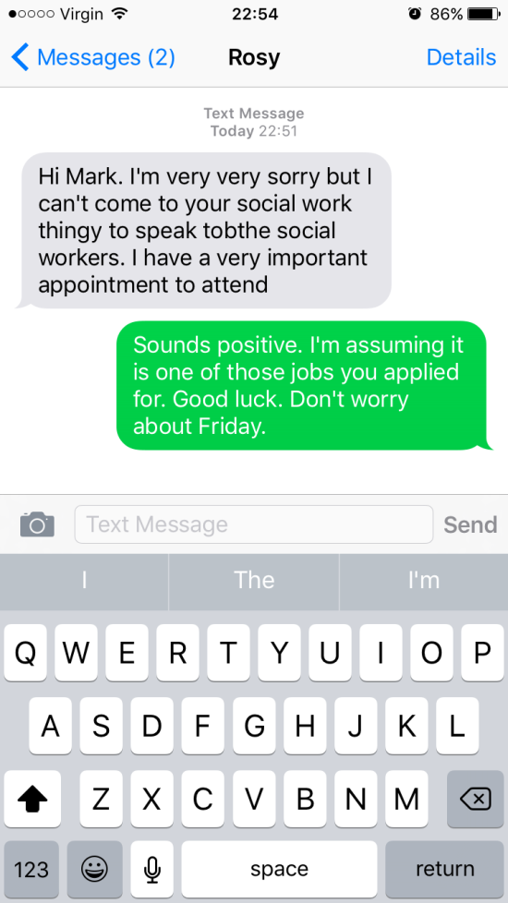
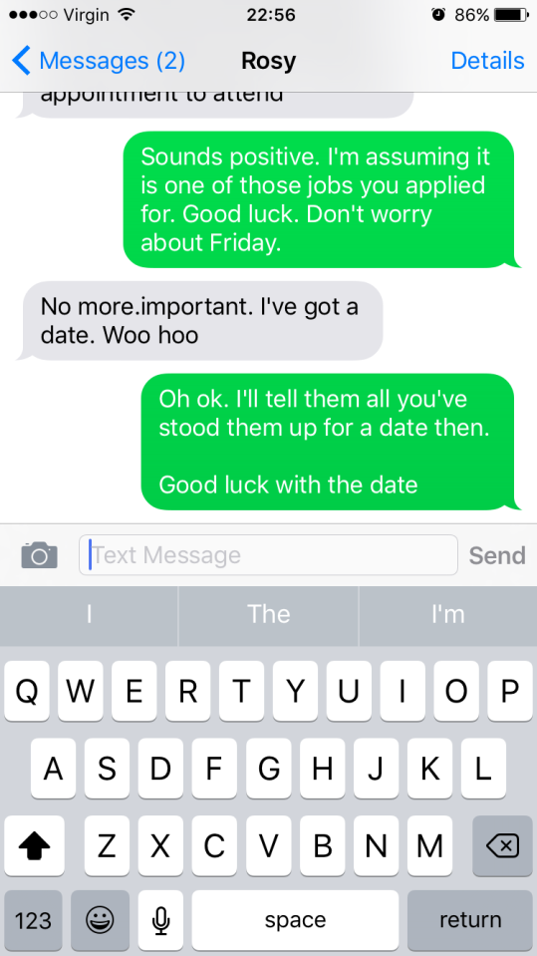
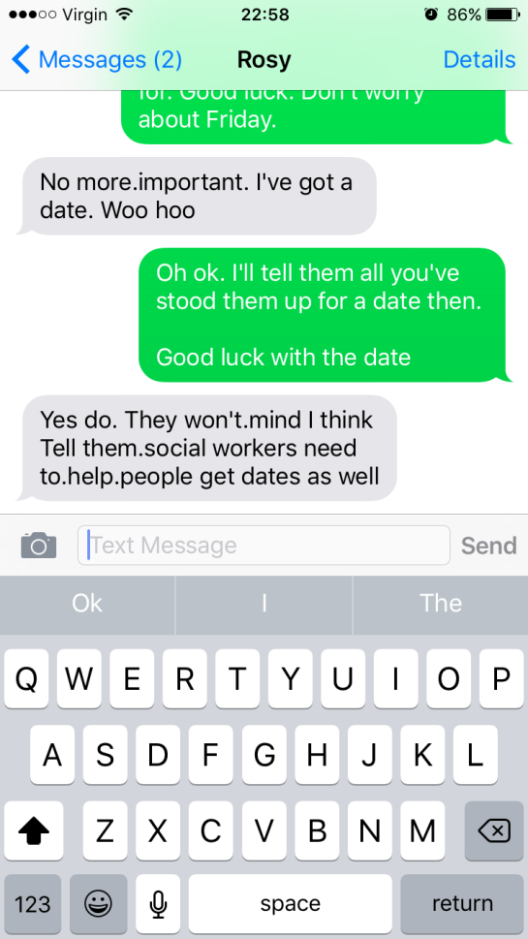
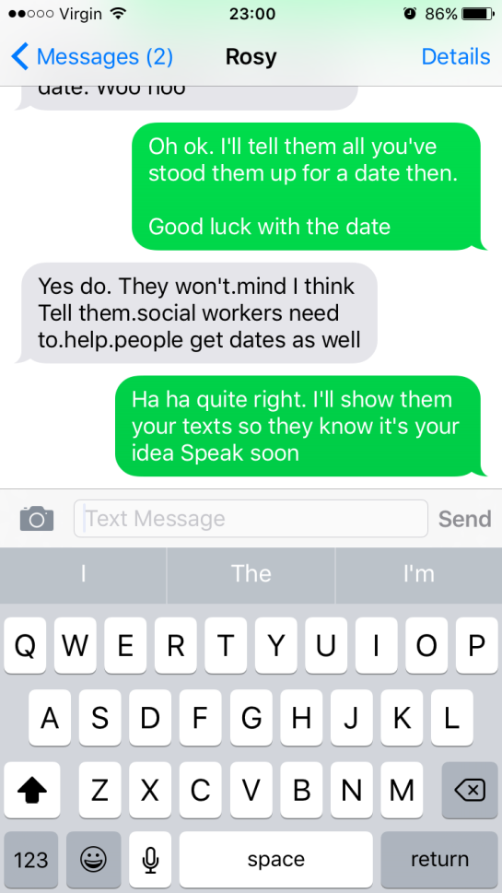
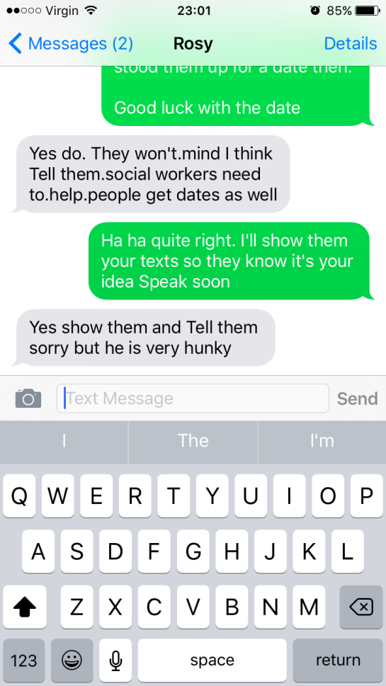

Slide 13
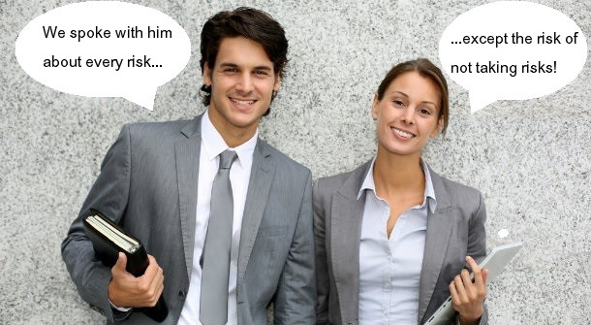
Risk Enabling
Our Risk Principles in our approach to Risk
1. Involving the person
Enable the person to be involved in considering the risks they face and in planning any actions to address them. Communication with the person should be adapted to their needs.
Some helpful questions (as provided by people with lived experience) to ask may be:
What is important in your life?
What is working well?
What things are difficult for you?
Do you think there are any risks?
Could things be done in a different way, which might reduce the risks?
Who is important to you?
Are there any differences of opinion between you and the people you said are important to you?

Slide 14
Risk Enabling
2. Involve the network around the adult, to the degree the person wishes (e.g. family members, friends, support networks). Strengths and asset based.
3. Multi-agency best practice Involve and work collaboratively with other agencies around the person to gain a full picture, assess risk and plan any strategy to address it. This is especially important where issues are complex and/or the impact of the risk is judged very severe. This will involve sharing information appropriately and reaching agreement as to how to proceed but it’s your assessment and judgement.
4. Assess Risk For each identified risk, you will have completed the risk management plan including gross, mitigation and then net.
Note the strengths of the person and what the risk may help them to achieve (and that they value).

Slide 15
Risk Enabling
5. Risk Management
Consider actions to mitigate the risk. Planning this will involve consideration with the person we support and those important to them around:
the outcomes that the person wants to achieve (their balance between their own safety and wellbeing);
the resources and assets around the person and in their community, and how these could be used to reduce the risk;
the impact on their wellbeing of any proposed actions to mitigate the risk; and
the emphasis should be upon achieving an acceptable balance between reducing risk and the impact this may have upon the person’s wellbeing.

Slide 16
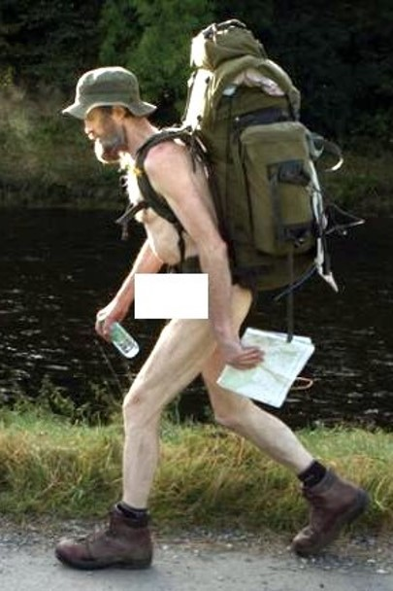
Risk Enabling
6. Risk of harm to others
Consider the impact of the risk, and any action to address it, upon others. Remember that an individual’s right to take risks does not give them the right to put others at risk.
7. Mental Capacity
Consider the adult’s ability to understand and make decisions about the risks they face and where doubt about this exists, ensure that the principles of the Mental Capacity Act 2005 are followed.

Slide 17
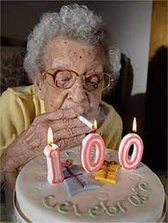
Risk Enabling
Principles 1 & 3 of the MCA say that unless established otherwise, every person is able make a specific decision at the time it needs to be made, and that making an unwise decision is not evidence of incapacity, though it might trigger an assessment which the person can still refuse.
Every effort will be made to support the individual with decision making but if the person chooses to live with that level of risk – and to refuse all offers of support – so it goes. But there are still things you can do, including keeping accurate records.

Slide 18
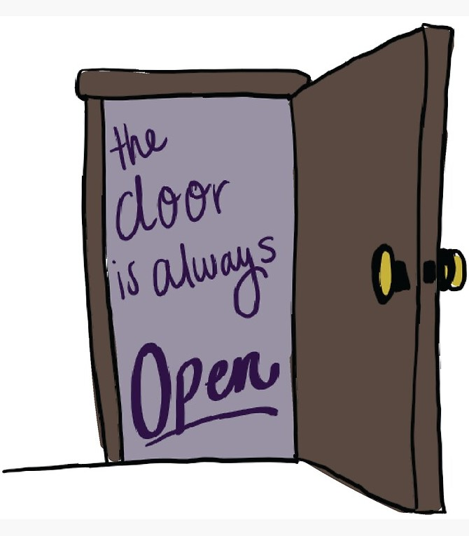
Risk Enabling
Where such a person informs the worker they do not want anything from the Local Authority, their right to reject offers of support will be respected.
However, we do not just walk away and leave them to it; the door will remain open in case the person changes their mind, we maintain contact and will liaise with others to whatever degree we can without it becoming an unjustified interference with their right to respect for privacy. The person will know, maybe via a letter, how to contact the dept in case they change their mind. Nothing is permanent.
If the person says, “I want you to close everything down, don’t ever contact me again…” We will respect that, but please do seek advice!

Slide 19

Final thoughts, questions
and follow-up

